Slide 1
ISA
Ibrahim S. Al-Akash
Welcome to my development portfolio!
I am pursuing a software engineering internship centered on systems, mobile, or web application development. I’m dedicated to contributing to a forward-thinking team while cultivating industry skills. With experience in both solo and team projects, I have a proven ability to learn quickly and build innovative solutions. I thrive on challenges and am committed to pushing my boundaries.

Slide 2


Experience
Bioengineering Intern
Product R&D Engineering Intern
Software Engineering Intern
Aug ’22
BCM Ray Lab
May ’23
Starling Medical
May ’24
Starling Medical

Slide 3





Projects
IMAGE
Apparatus for automating and parallelizing experiments on genetically engineered mice for sudden infant death syndrome (SIDS) research
Ray Lab

Slide 4
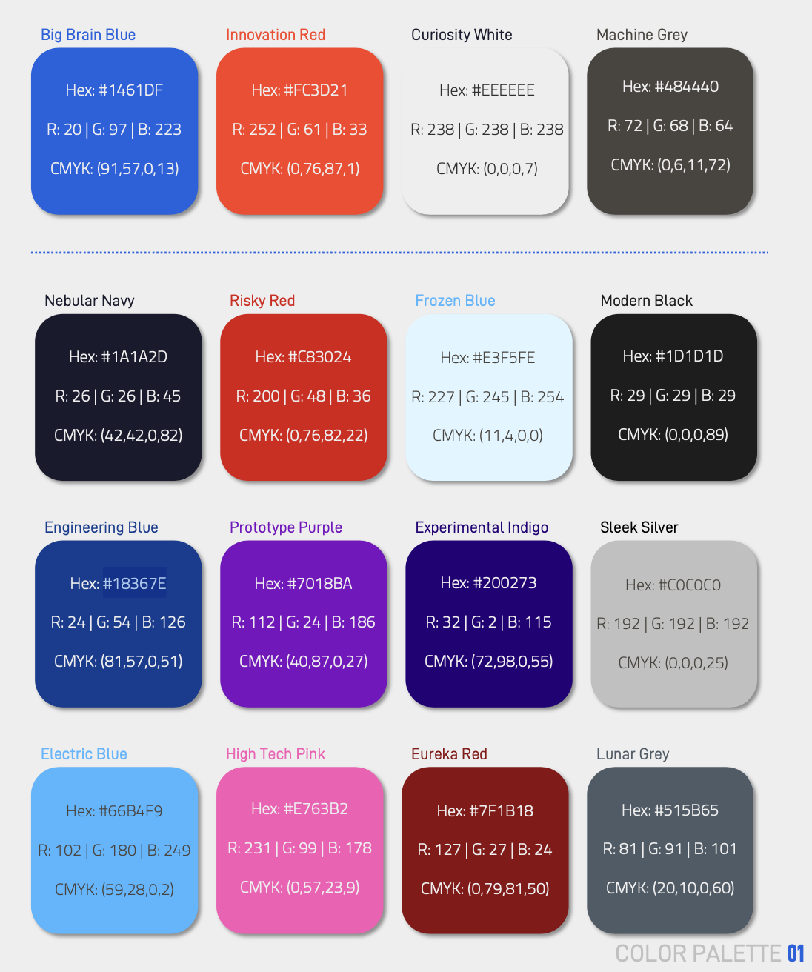

Slide 5
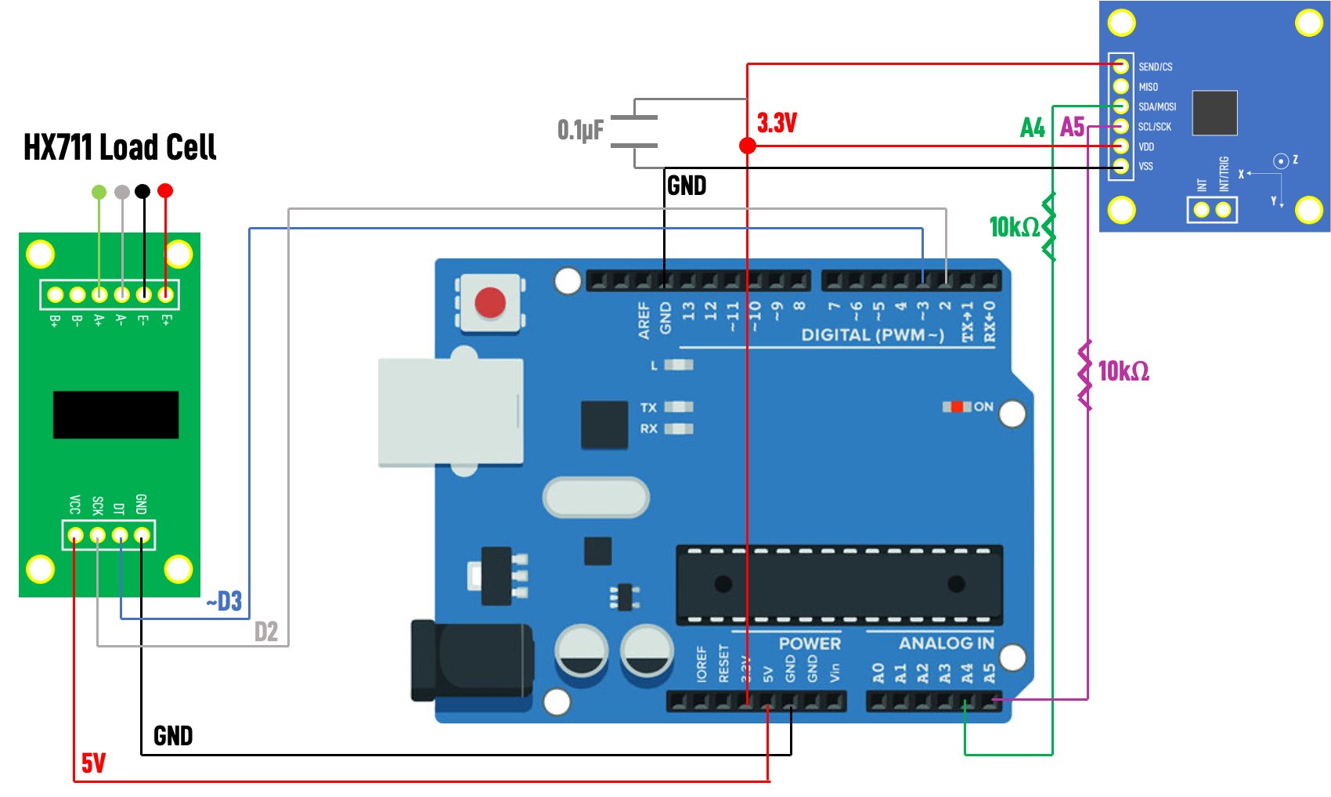

Slide 6
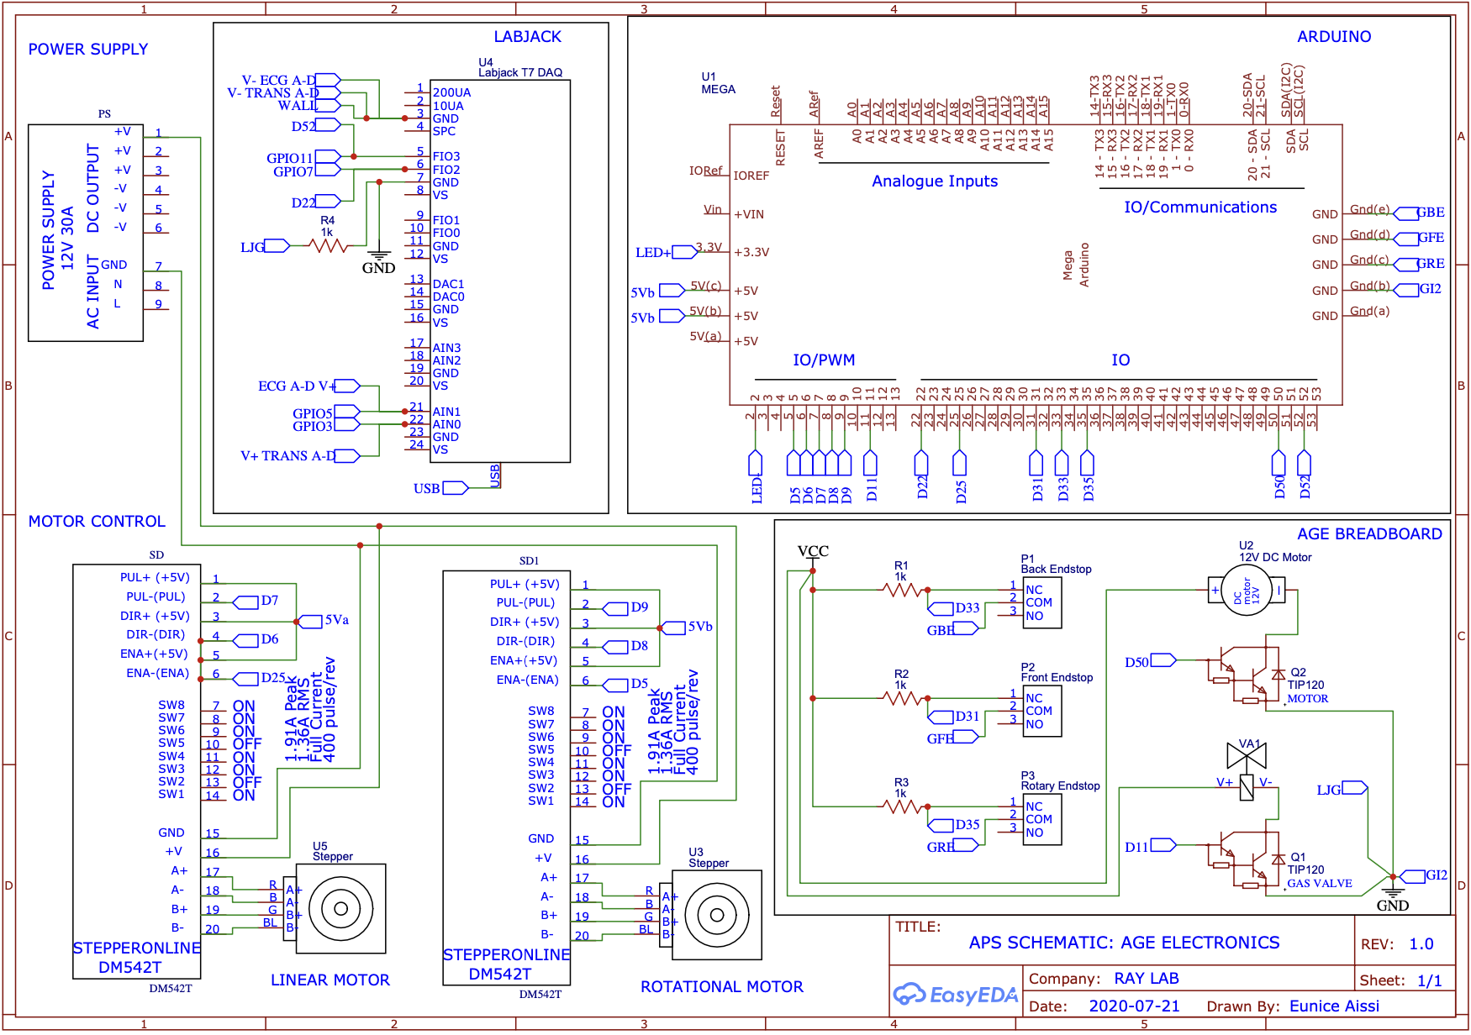

Slide 7


Slide 8
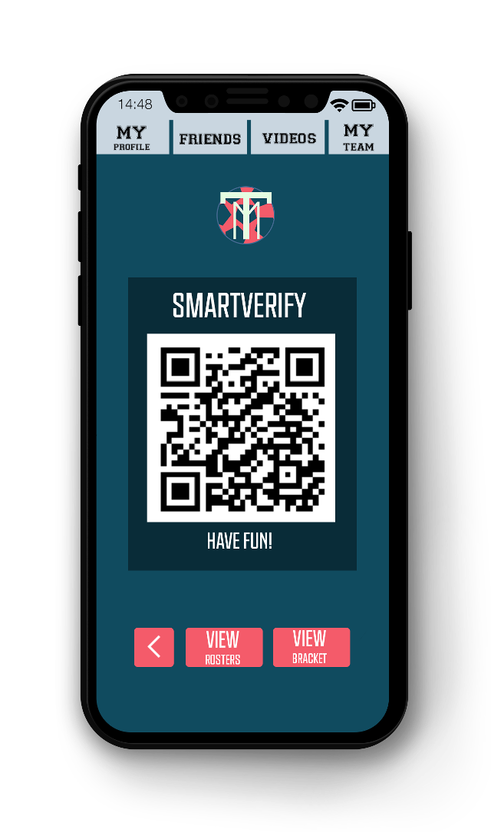
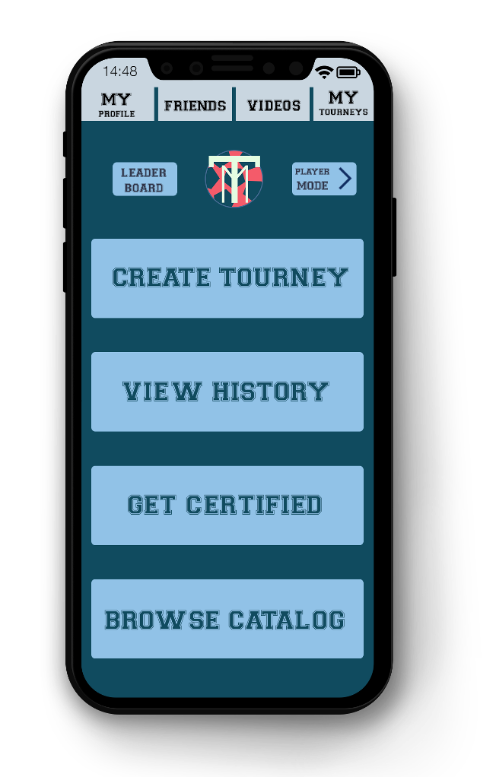
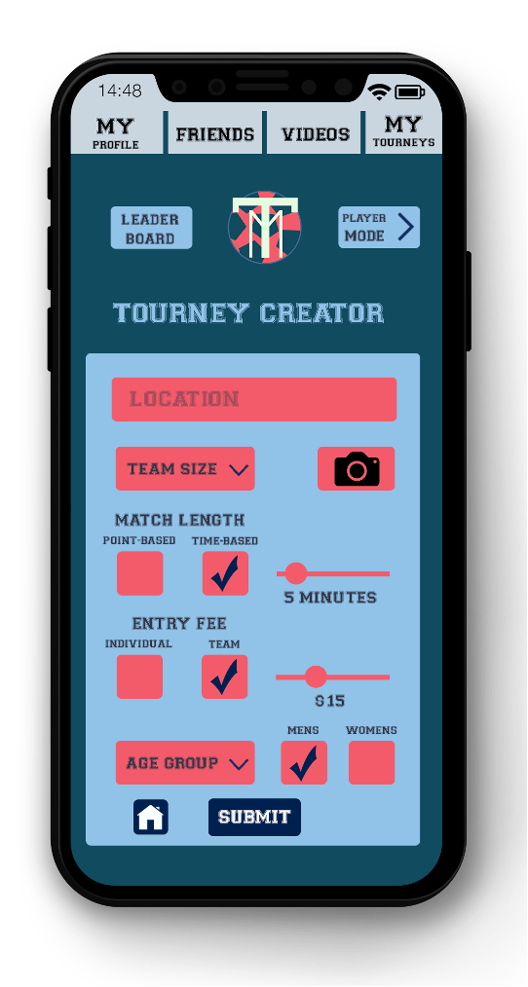

Slide 9
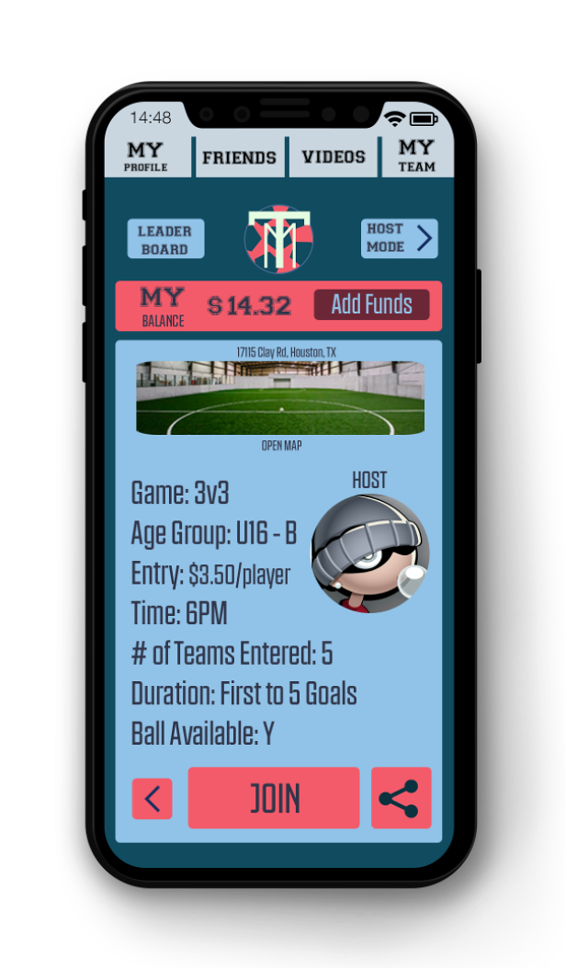
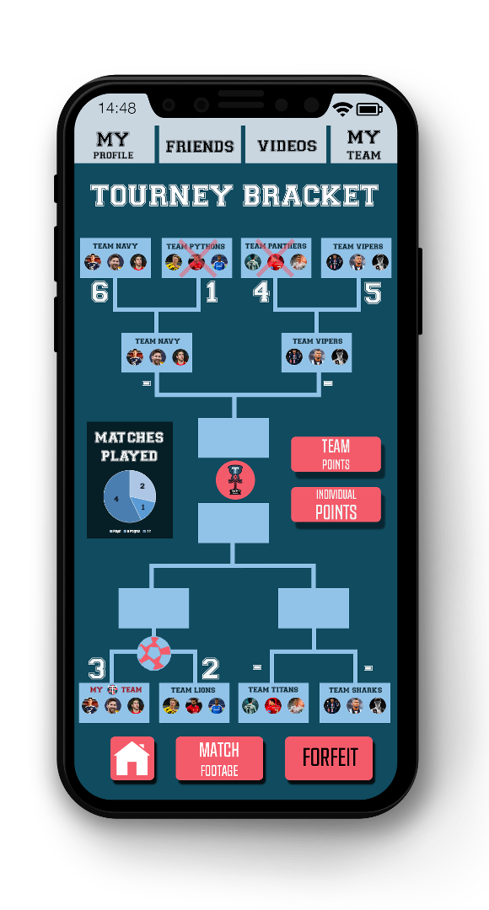
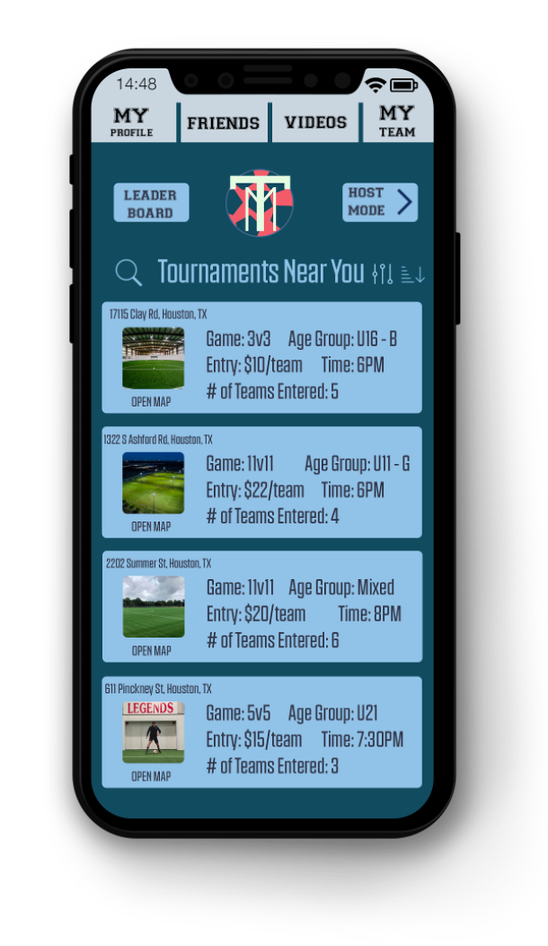
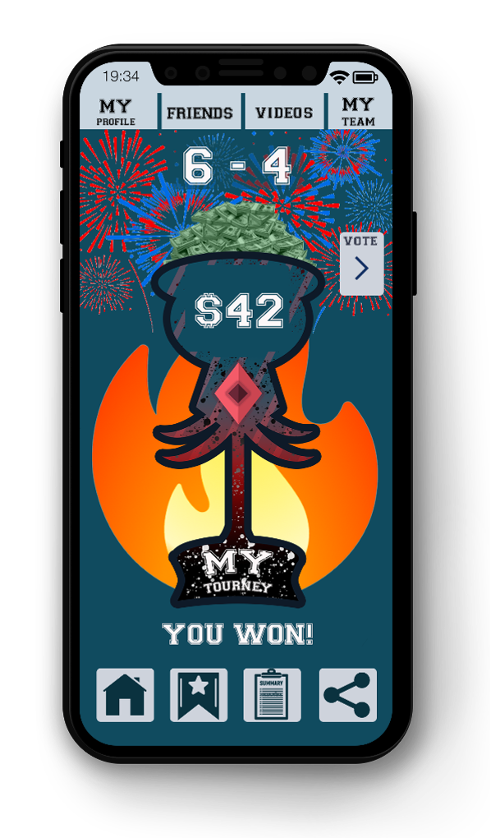

Slide 10
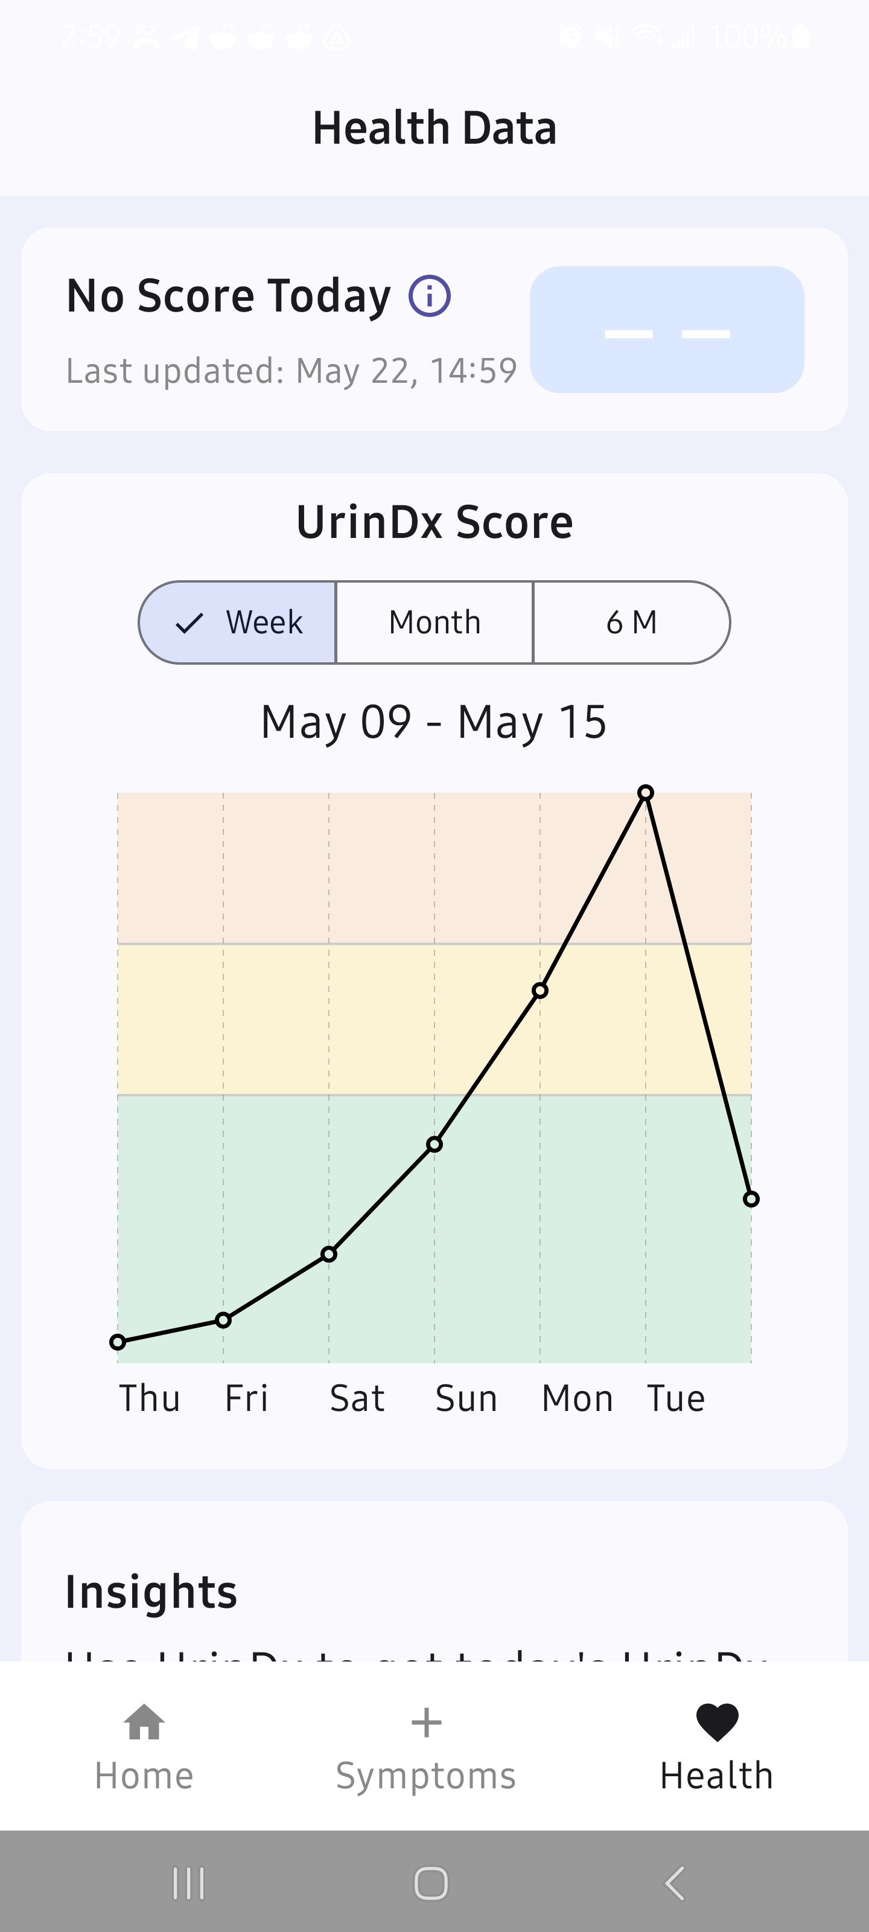
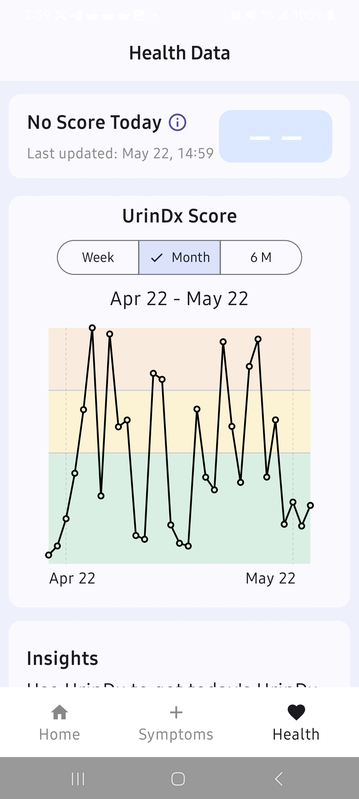
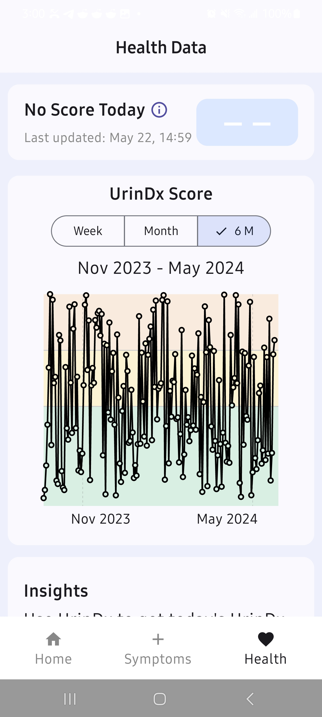

Slide 11
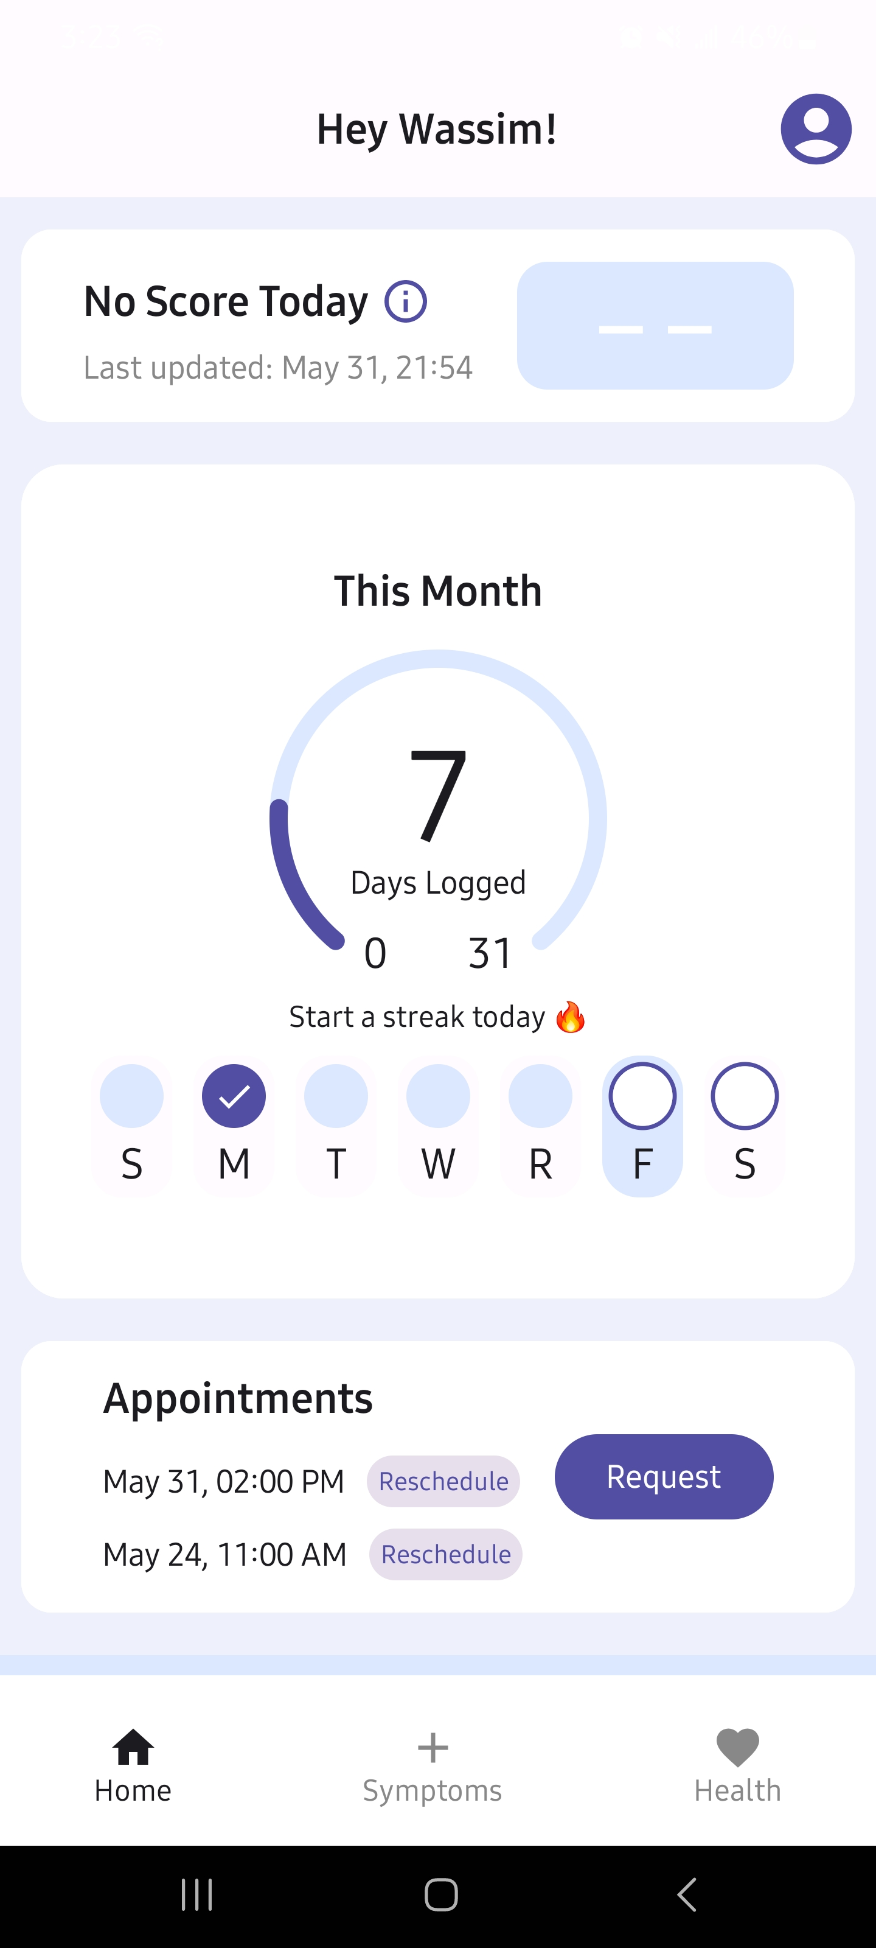
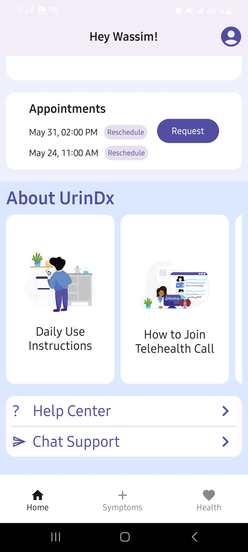
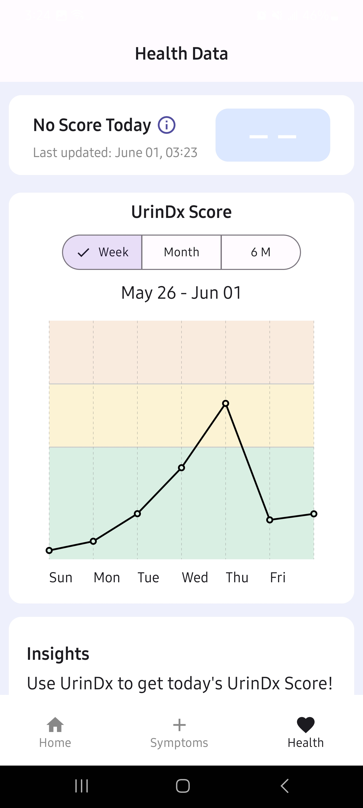
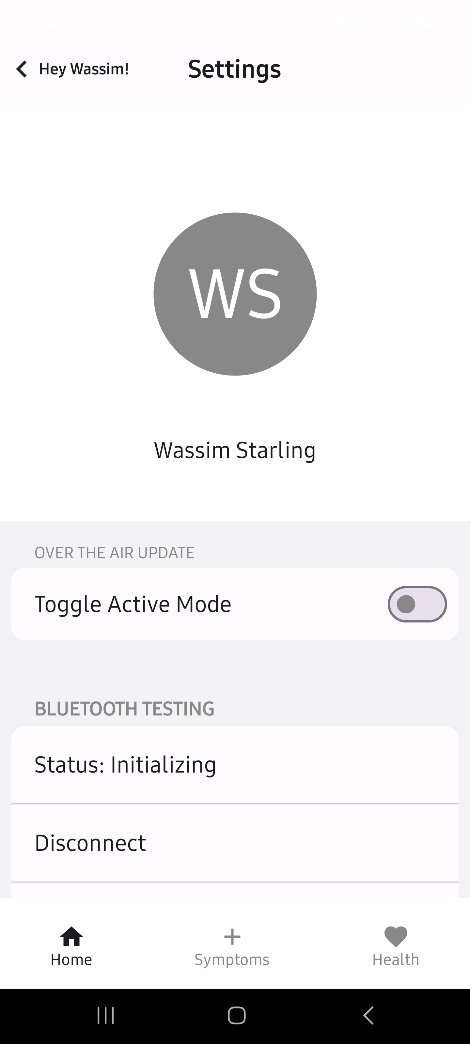

Slide 12
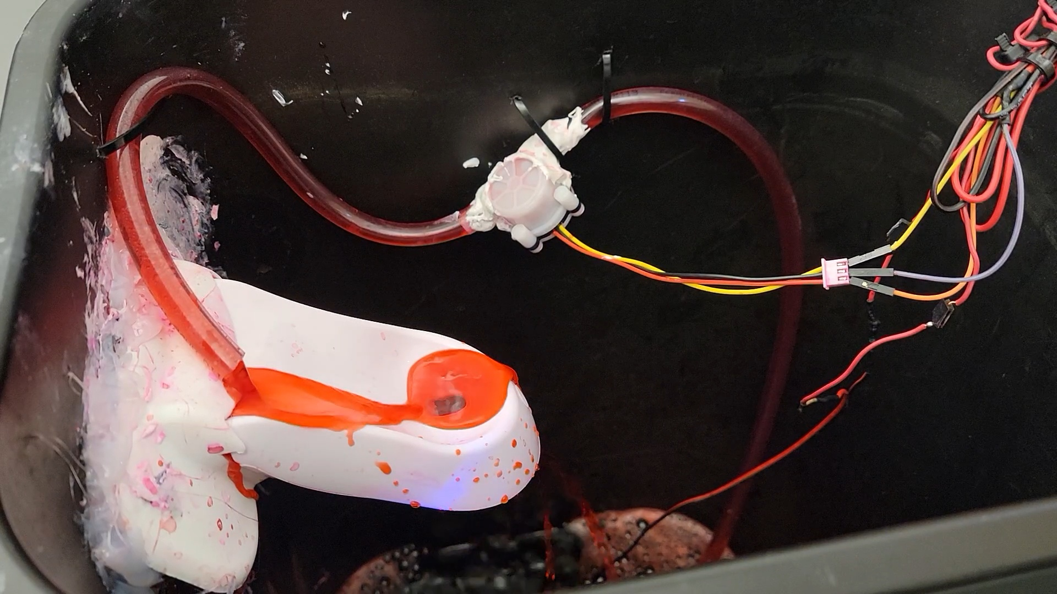

Slide 13



Slide 14
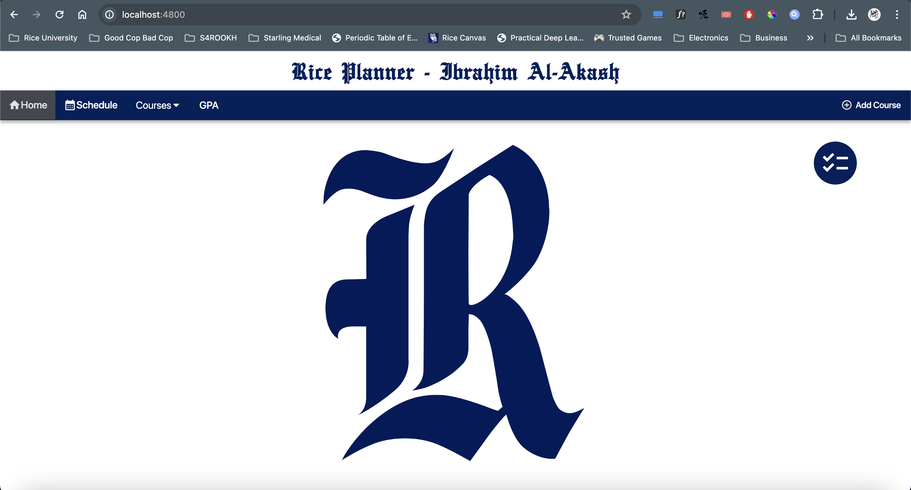

Slide 15
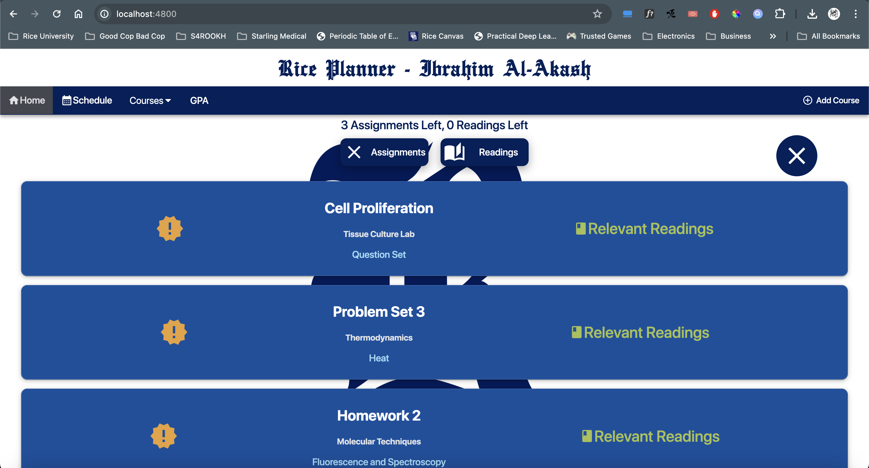

Slide 16
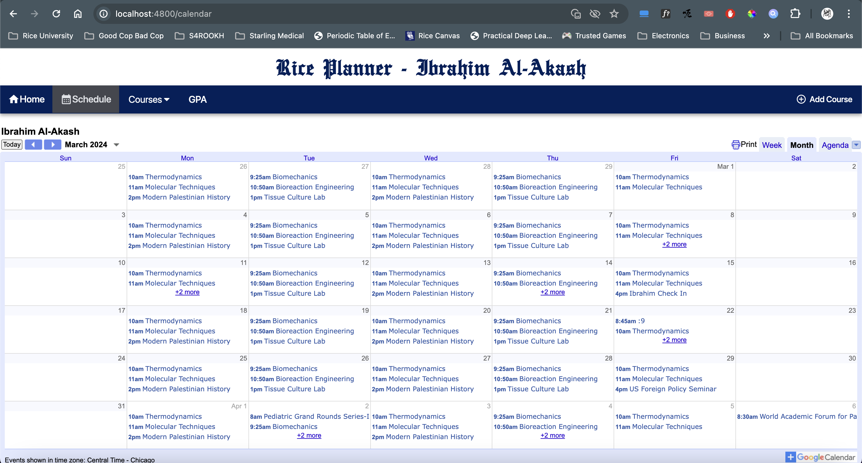

Slide 17
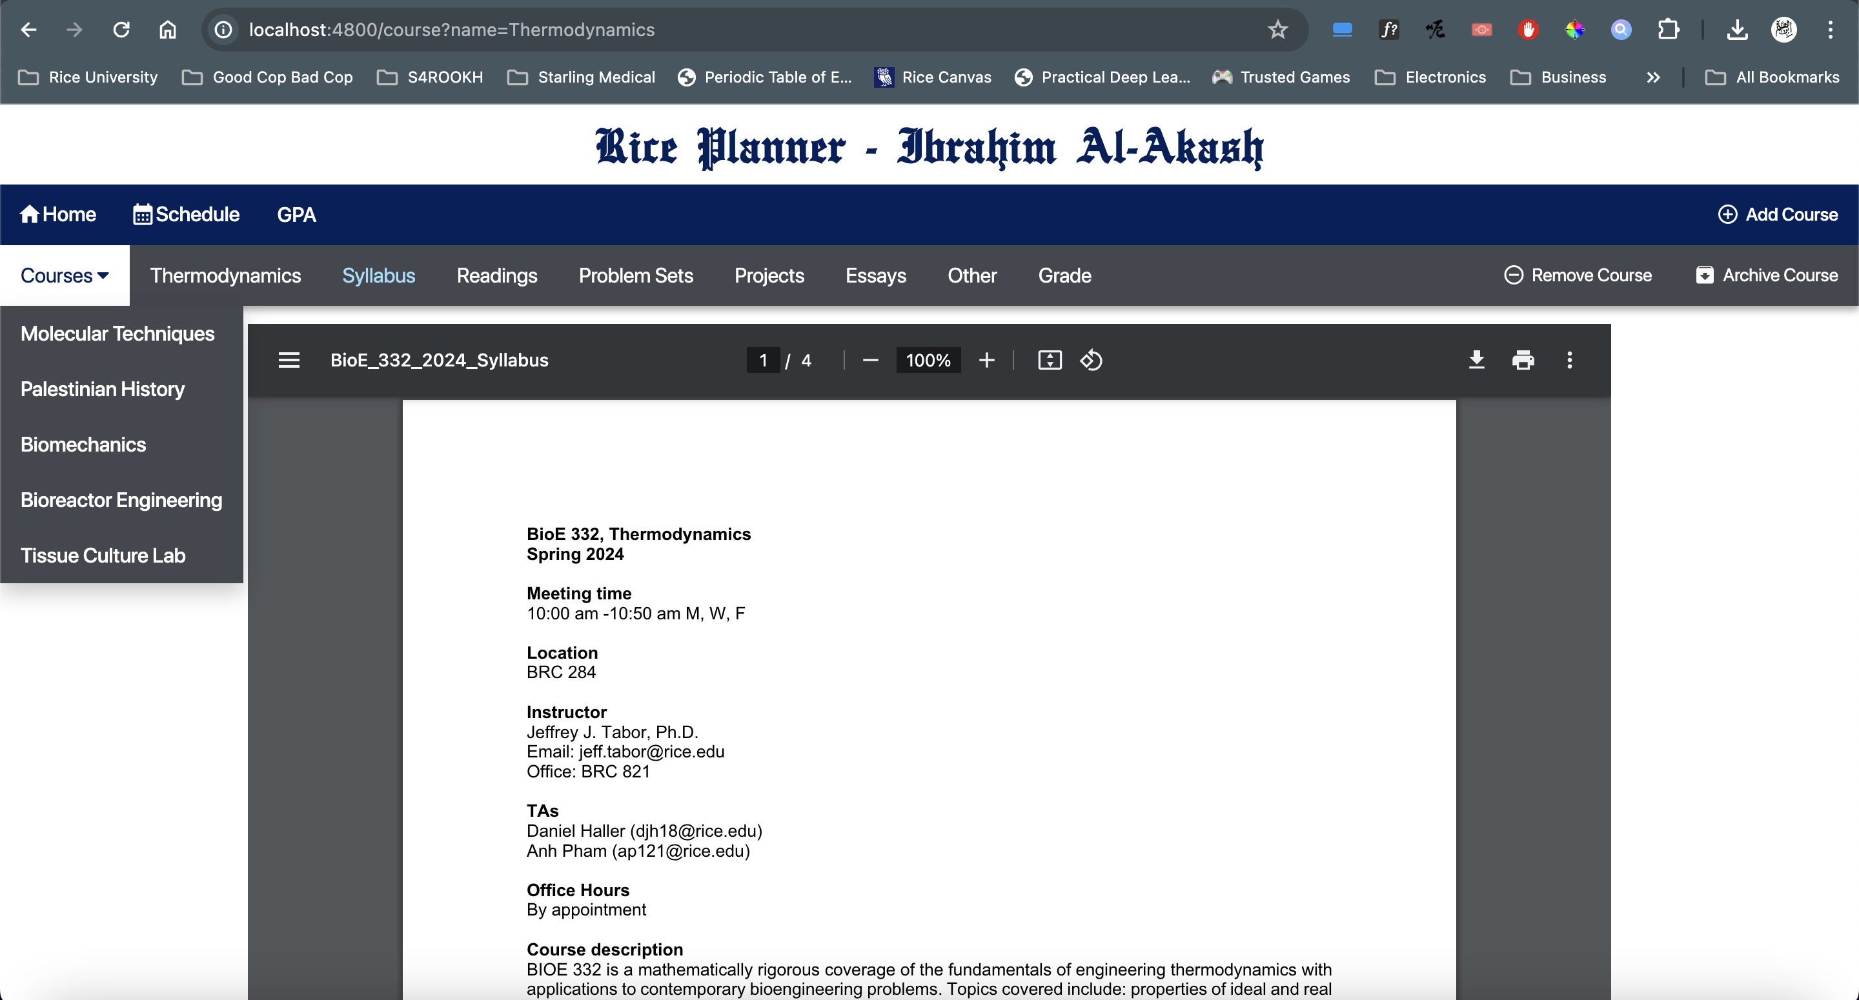

Slide 18
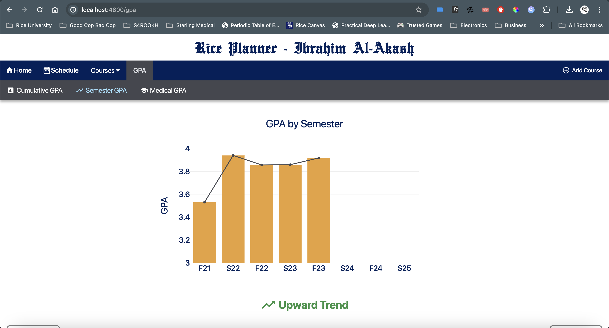

Slide 19
